Slide 1

Art Merit Badge
Troops 344/9344
Pemberville, OH

Slide 2
Art Merit Badge Requirements
Discuss the following with your counselor:
  What art is and what some of the different forms of art are
  The importance of art to humankind
  What art means to you and how art can make you feel
Discuss with your counselor the following terms and elements of art: line, value, shape, form, space, color, and texture. Show examples of each element.
Discuss with your counselor the six principles of design: rhythm, balance, proportion, variety, emphasis, and unity.

Slide 3
Art Merit Badge Requirements
Render a subject of your choice in FOUR of these ways:
  Pen and ink,
  Watercolors,
  Pencil,
  Pastels,
  Oil paints,
  Tempera,
  Acrylics,
  Charcoal
  Computer drawing or painting

Slide 4
Art Merit Badge Requirements
Do ONE of the following:
  Design something useful. Make a sketch or model of your design. With your counselor's approval, create a promotional piece for the item using a picture or pictures.
  Tell a story with a picture or pictures or using a 3-D rendering.
  Design a logo. Share your design with your counselor and explain the significance of your logo. Then, with your parent's permission and your counselor's approval, put your logo on Scout equipment, furniture, ceramics, or fabric.

Slide 5
Art Merit Badge Requirements
With your parent's permission and your counselor's approval, visit a museum, art exhibit, art gallery, artists' co-op, or artist's workshop. Find out about the art displayed or created there. Discuss what you learn with your counselor.
Find out about three career opportunities in art. Pick one and find out the education, training, and experience required for this profession. Discuss this with your counselor, and explain why this profession might interest you.

Slide 6

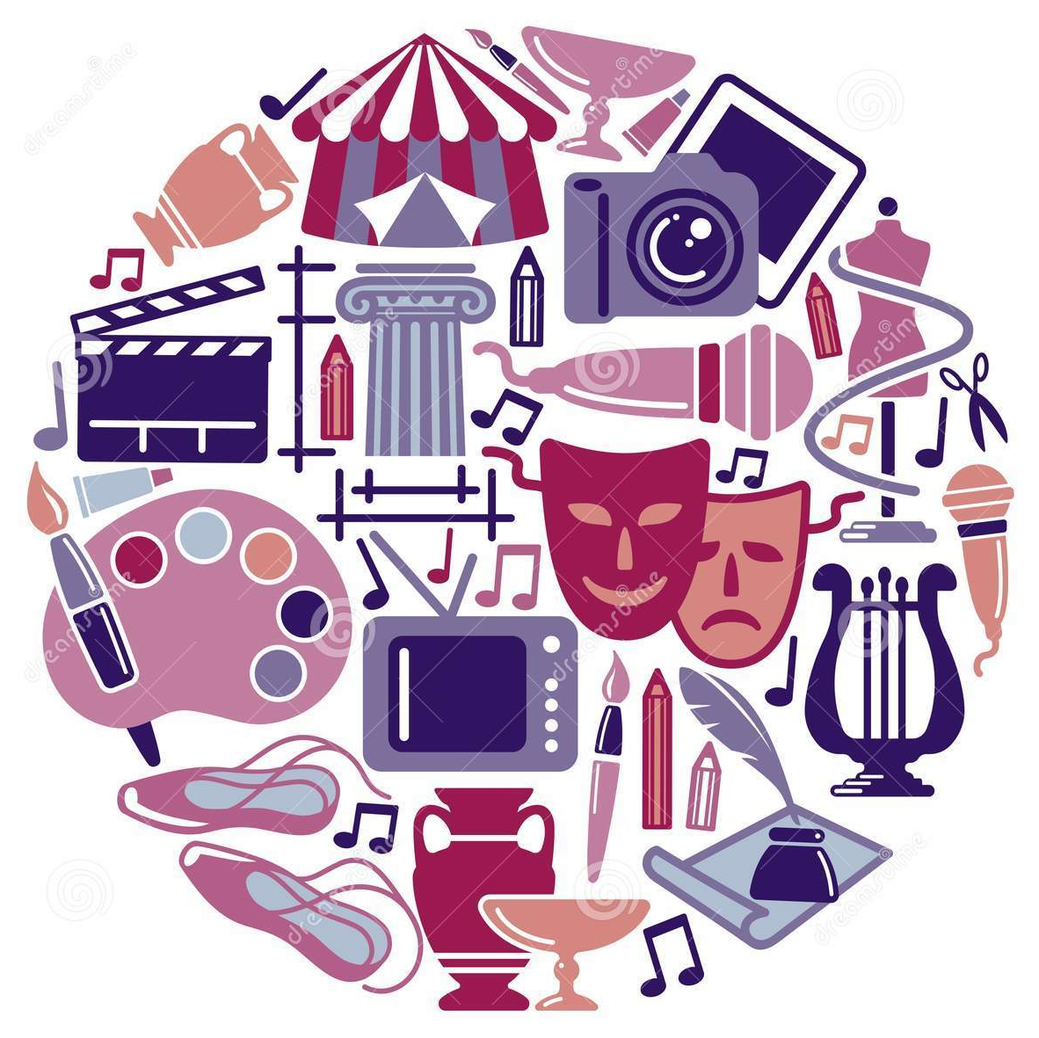
Requirement 1
Discuss the following with your counselor:
  What art is and what some of the different forms of art are
  The importance of art to humankind
  What art means to you and how art can make you feel

Slide 7
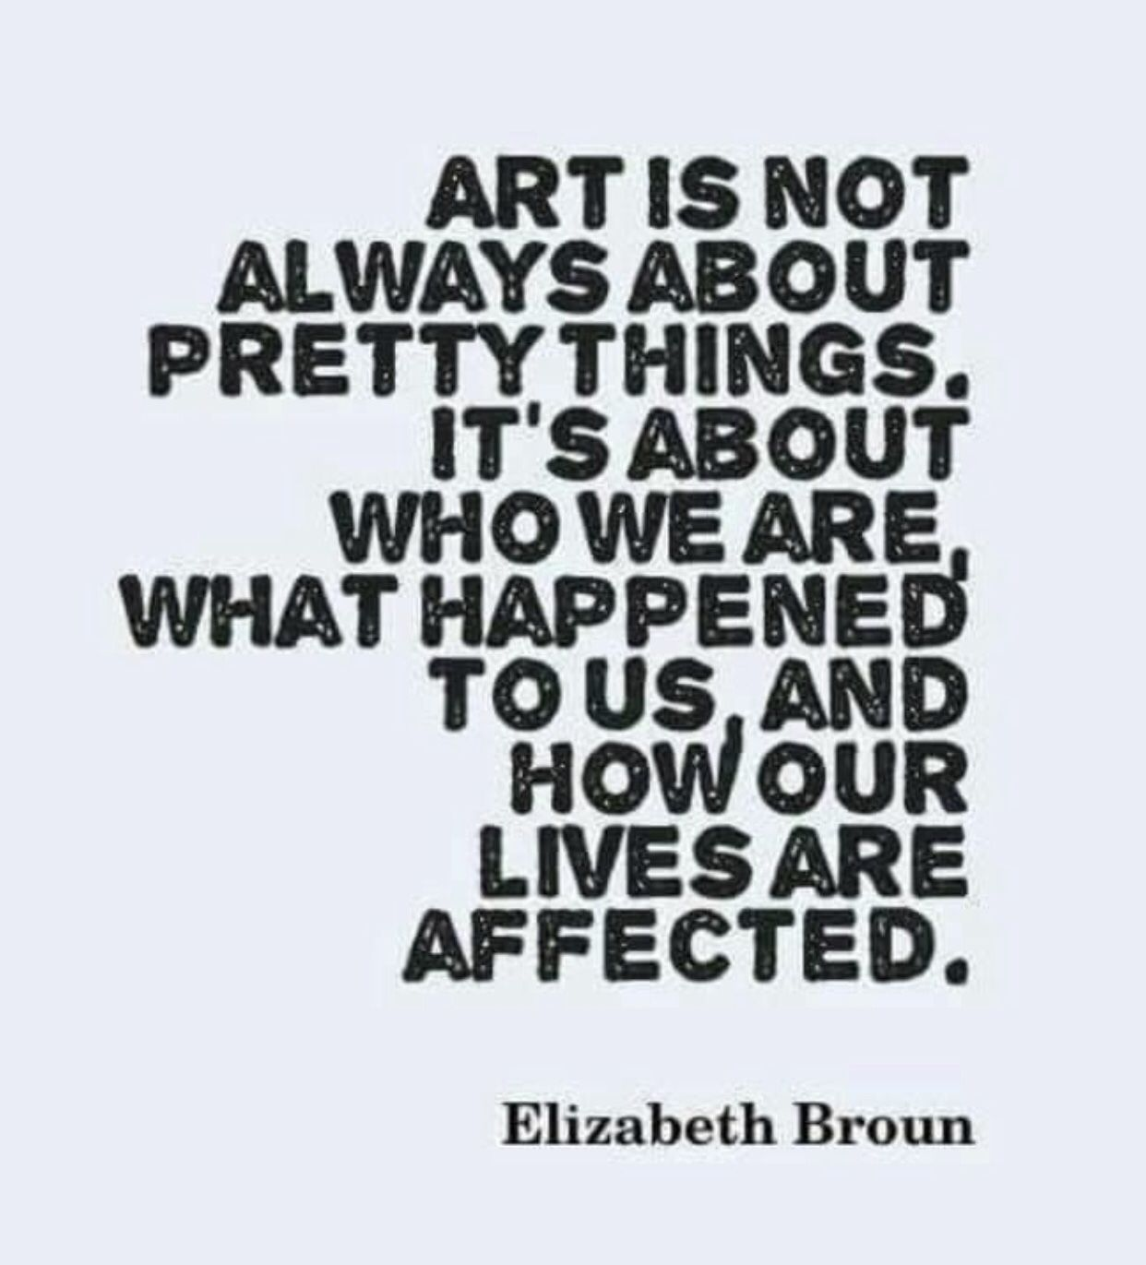
1a What is Art?
Art is a wide range of human activities that involve creative imagination and aim to express the author’s imaginative or technical skill, and are intended to be appreciated for their beauty, emotional power, or conceptual ideas.
There is no generally agreed definition of what constitutes art, and ideas have changed over time.

Slide 8
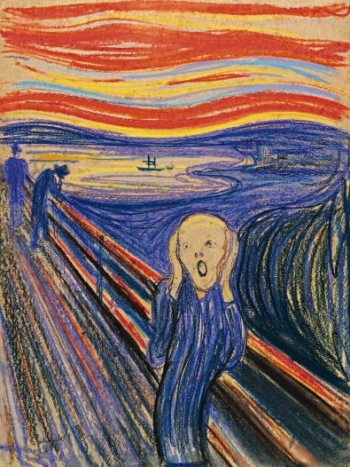

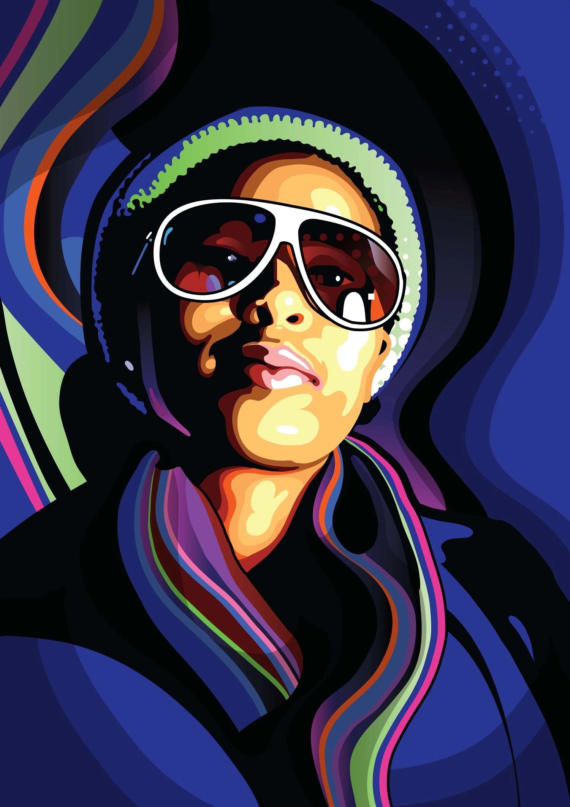
1a Forms of Art
Ten Different Forms of Art:
  Painting.
    A painting is a work of art constructed using pigments to create a design on a canvas or paper.
    Watercolors, acrylics, and pastels are all different mediums that can be used to create a painting.
  Graphic Design.
    Graphic design is a form of digital art that uses visual content to create designs.
  Illustration.
    This contemporary art style is often seen in books, video games, and digital designs.
    An illustration is an interpretation of a text in a visual format.

Slide 9
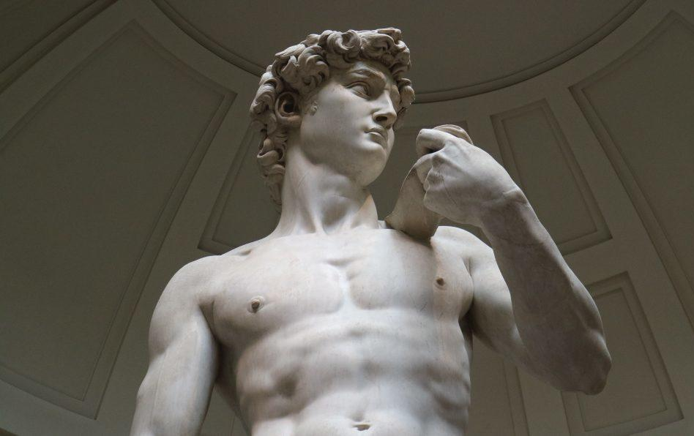
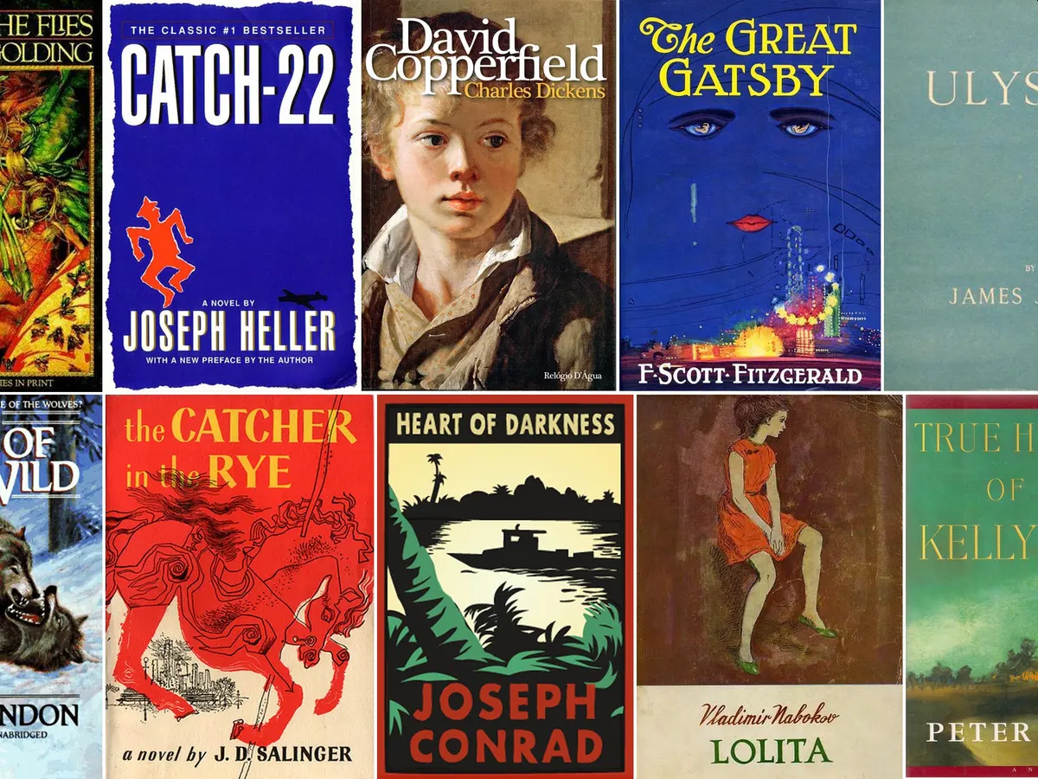
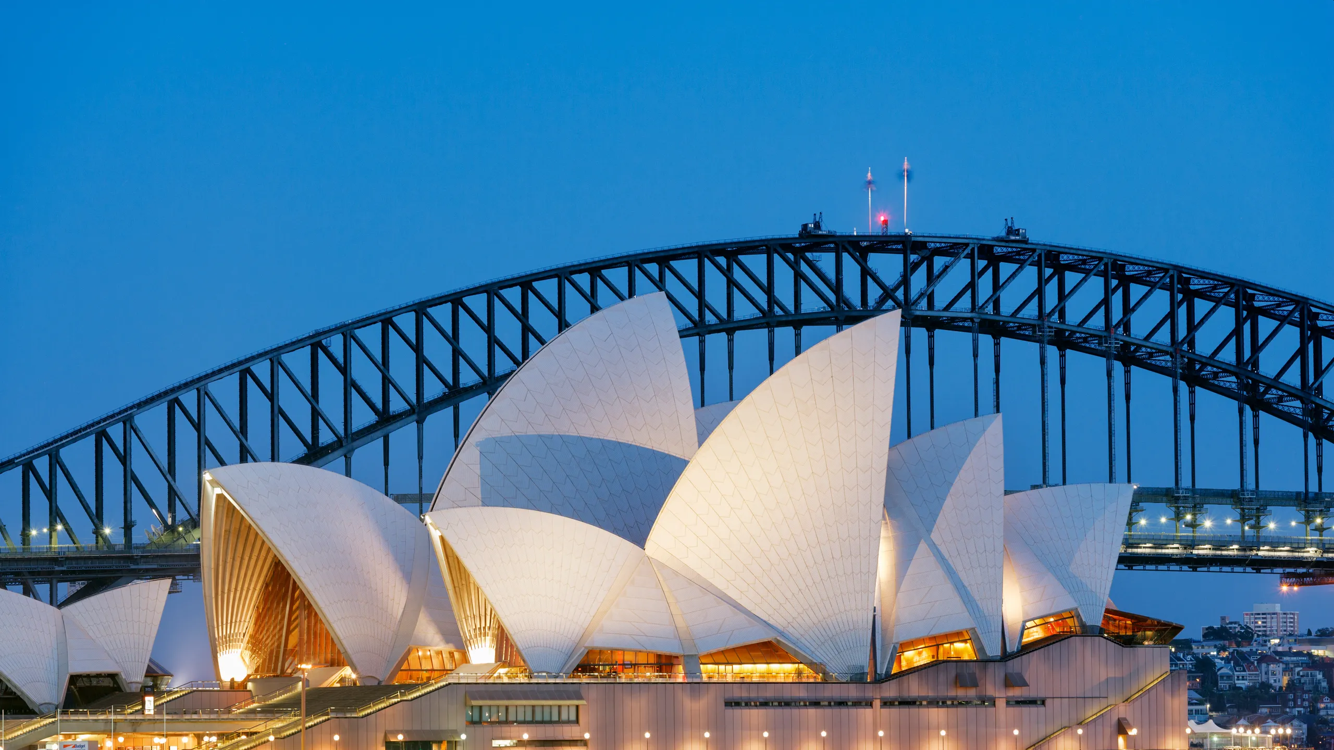
1a Forms of Art
Ten Different Forms of Art:
  Sculpture.
    Sculpture is the creation of two or three-dimensional forms by carving into a material.
  Literature.
    Literature is the art of sharing stories using the written word.
  Architecture.
    Architecture is the art of designing and constructing buildings.

Slide 10
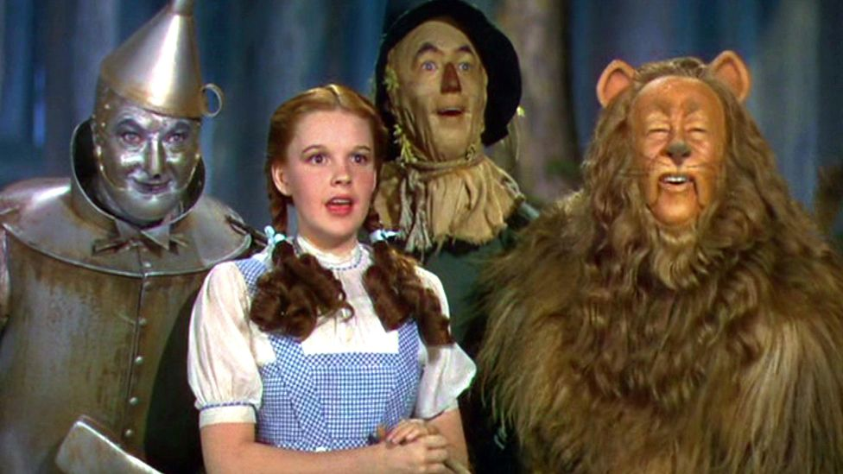
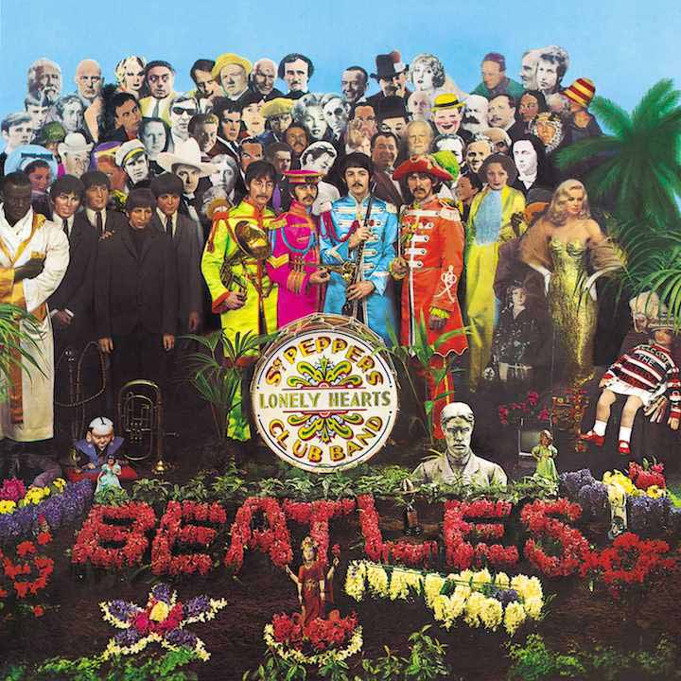
1a Forms of Art
Ten Different Forms of Art:
  Film.
    A style of art more commonly known as movies, motion pictures, or cinema, are moving pictures displayed on a screen that relay a story.
  Music.
    Music is defined as instrumental and vocal sounds joined together to create a harmonious sound.

Slide 11
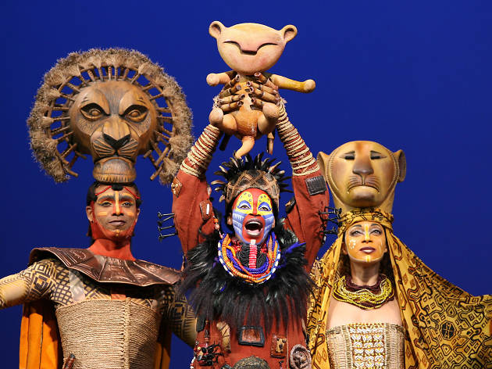
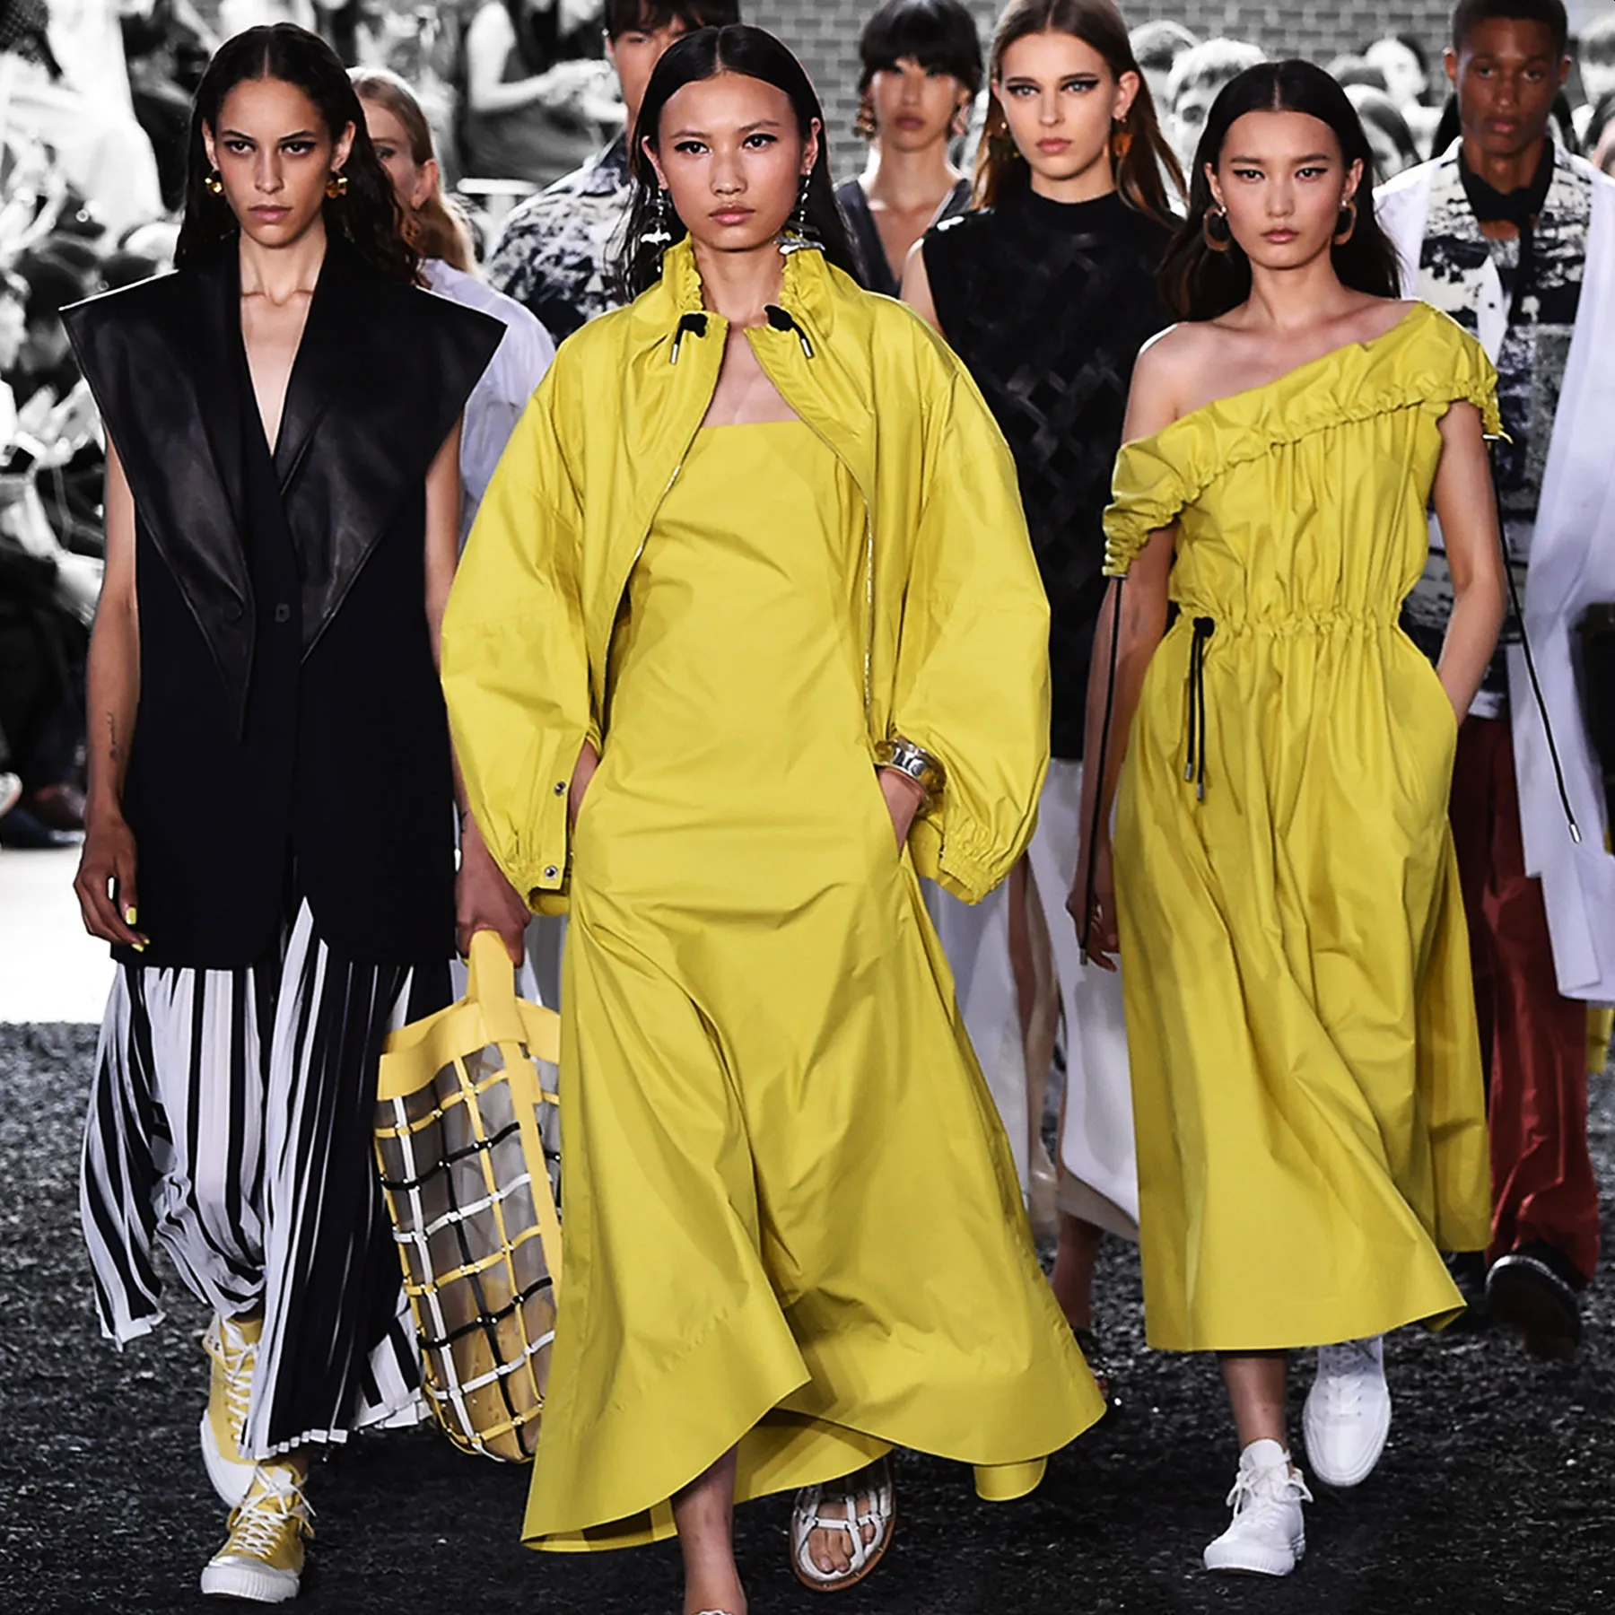
1a Forms of Art
Ten Different Forms of Art:
  Theater.
    Theater is defined as the act of acting in, directing, or writing plays. The art of theater combines acting, movement, and often singing.
  Fashion.
    Fashion is a form of self-expression and art that involves styling clothing, accessories, makeup, or hairstyles to make a statement.

Slide 12
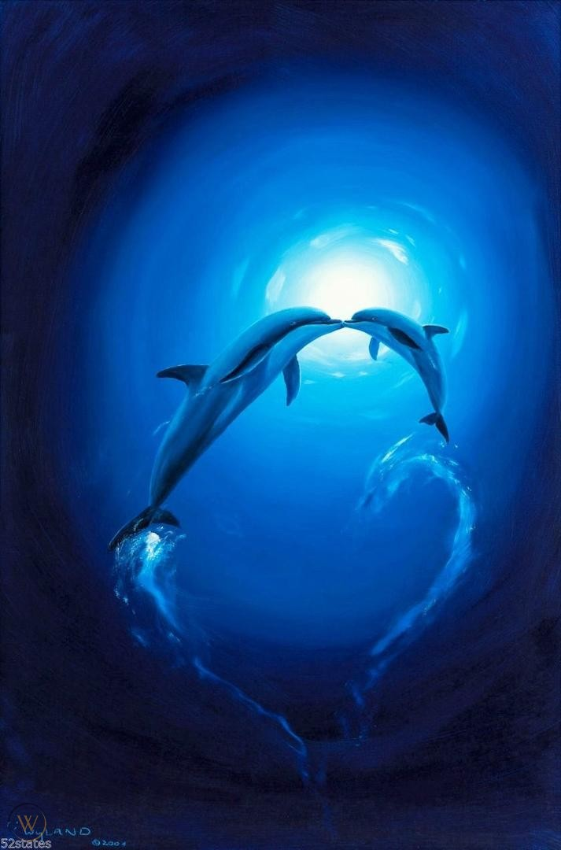
1b Importance of Art
10 reasons why art is important to our world:
  Art is natural human behavior.
    Humans have been creating since the beginning of time.
  Art is a language.
    “A picture is worth a thousand words.”
    Art is able to say things that words sometimes can’t.
  Art tells a story.
    Art is important because it’s a way of documenting and preserving our history.
  Art is therapeutic.
    Art is a great way to calm yourself and decrease stress levels.
  Art evokes emotions from people.
    Art is important because it has the power to move people and sometimes an entire nation.
    Think of films or songs that have gone viral around the world and created either awareness or inspired others to do great things.

Slide 13
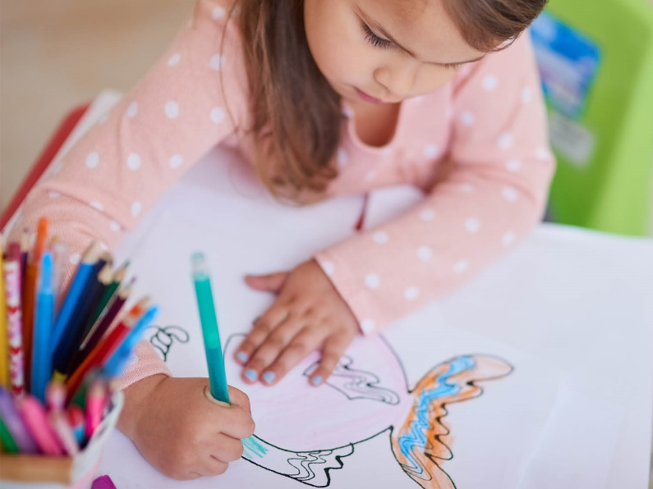

1b Importance of Art
10 reasons why art is important to our world (continued):
  Art increases creativity.
    The more you work on art the more creative you’ll get.
  Art makes people happy when they create.
  Art is vital to human development.
    It helps to develop motor skills, eye-hand coordination and has a large impact on their social and emotional growth.
  Art can make drab places look amazing.
  Art is good for the economy.
    When artists make money from their hard work, they spend more money on art supplies, frequent surrounding places like restaurants, and events, making it good for the economy and small businesses.
    Also, when a community is bustling with creativity and has a vibrant art scene filled with attractions, tourists will come from all over to see.

Slide 14
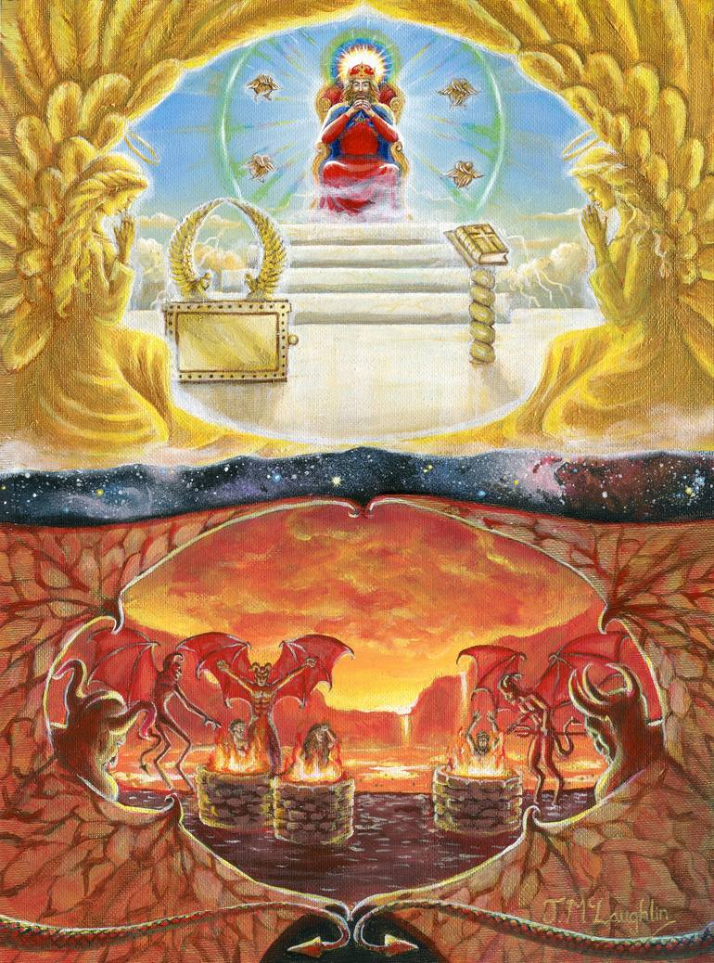
1c Meaning of Art
Art, in its broadest sense, is a form of communication.
It means whatever the artist intends it to mean, and this meaning is shaped by the materials, techniques, and forms it makes use of, as well as the ideas and feelings it creates in its viewers.
Art is an act of expressing feelings, thoughts, and observations.

Slide 15
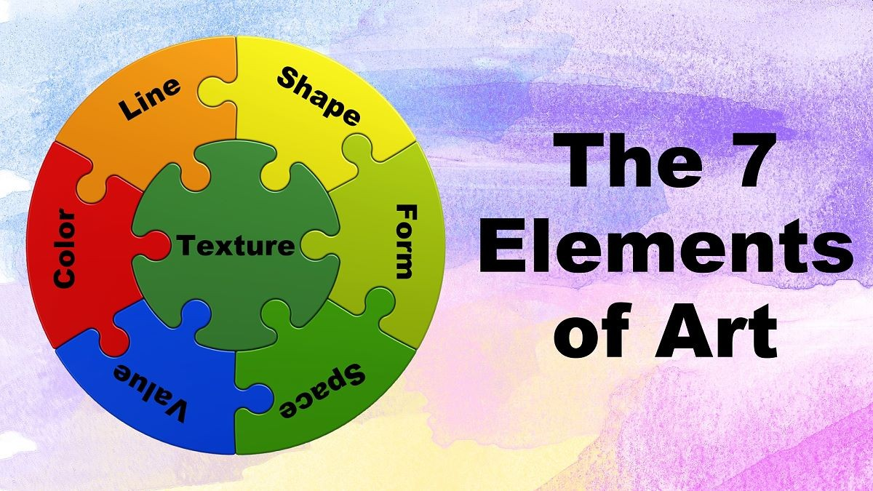
Requirement 2
Discuss with your counselor the following terms and elements of art: line, value, shape, form, space, color, and texture. Show examples of each element.

Slide 16
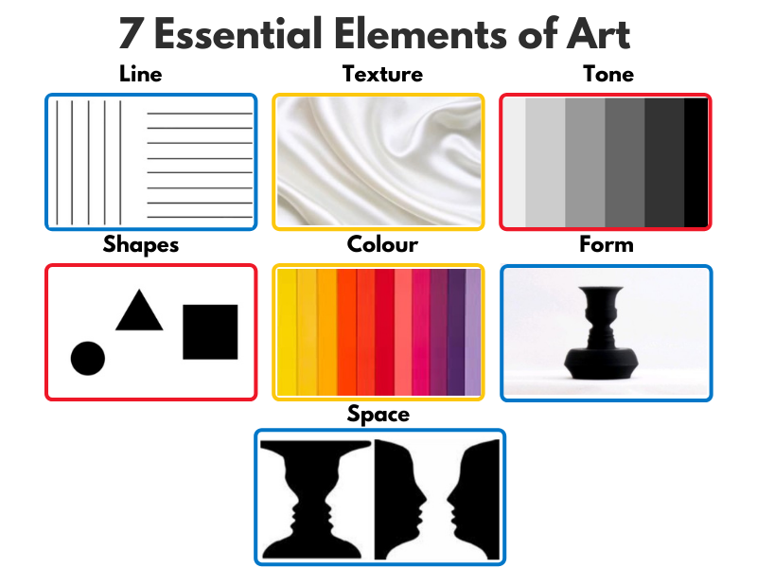
2 Elements of Art
The elements of art are the building blocks used by artists to create a work of art.

Slide 17
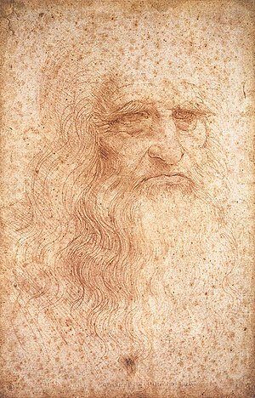
2 Line
Line is a mark with greater length than width. Lines can be horizontal, vertical, or diagonal; straight or curved; thick or thin.

Slide 18
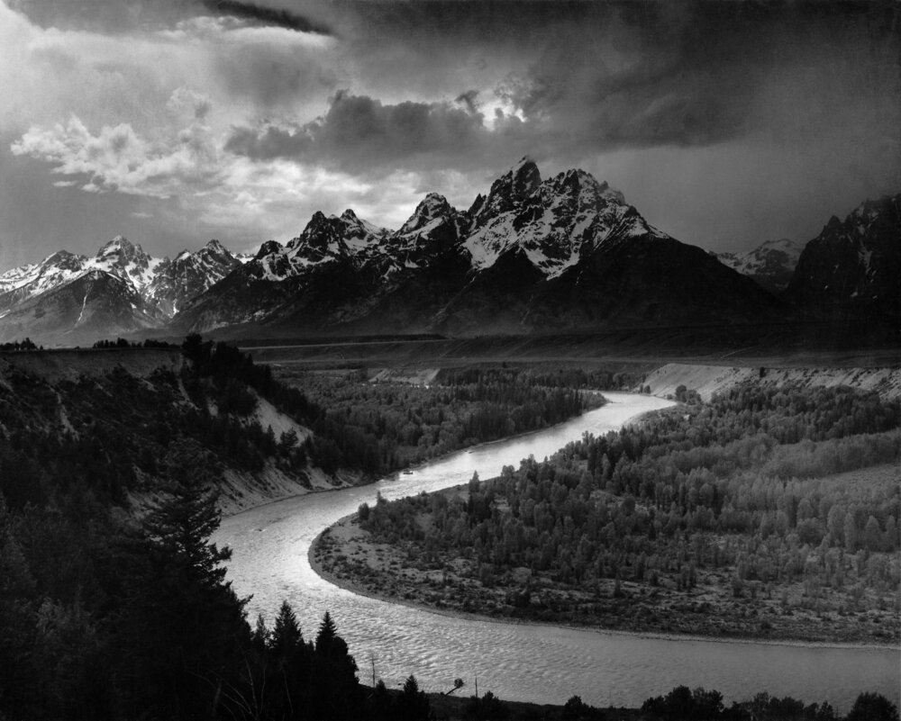
2 Value
Value is the lightness or darkness in color.
The lightest value is white and the darkest value is black.
The difference between values is contrast.
You can study the use of value in monochromatic or black and white pieces of art.

Slide 19
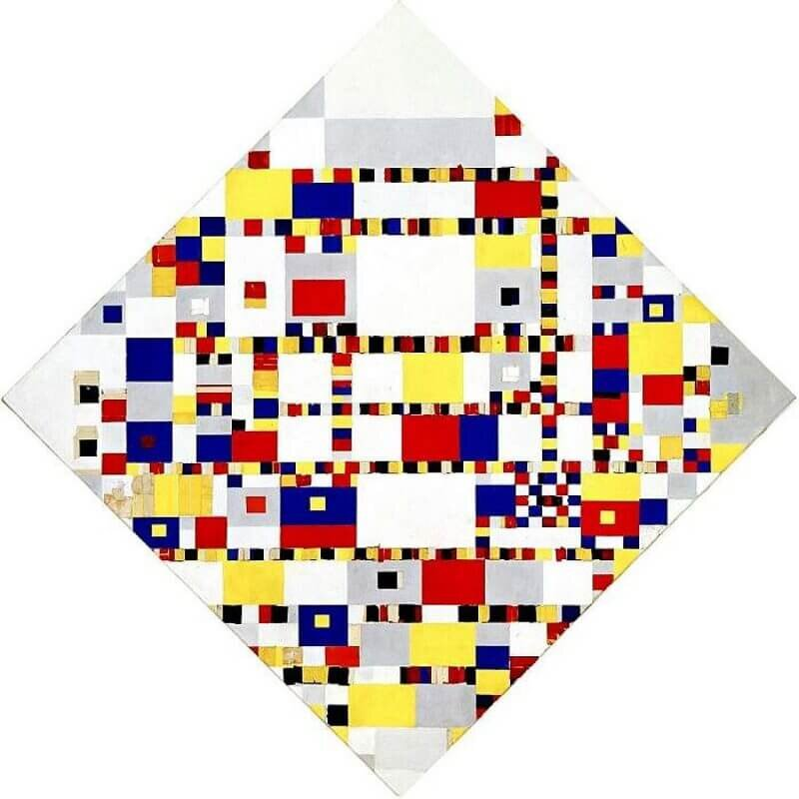
2 Shape
Shape is the result of closed lines, they are two dimensional and flat.
Shapes can be geometric, such as squares or triangles or they can be organic and not have defined parameters and are more curved and abstract.
Shapes in art can be used to control how the viewer perceives a piece.

Slide 20
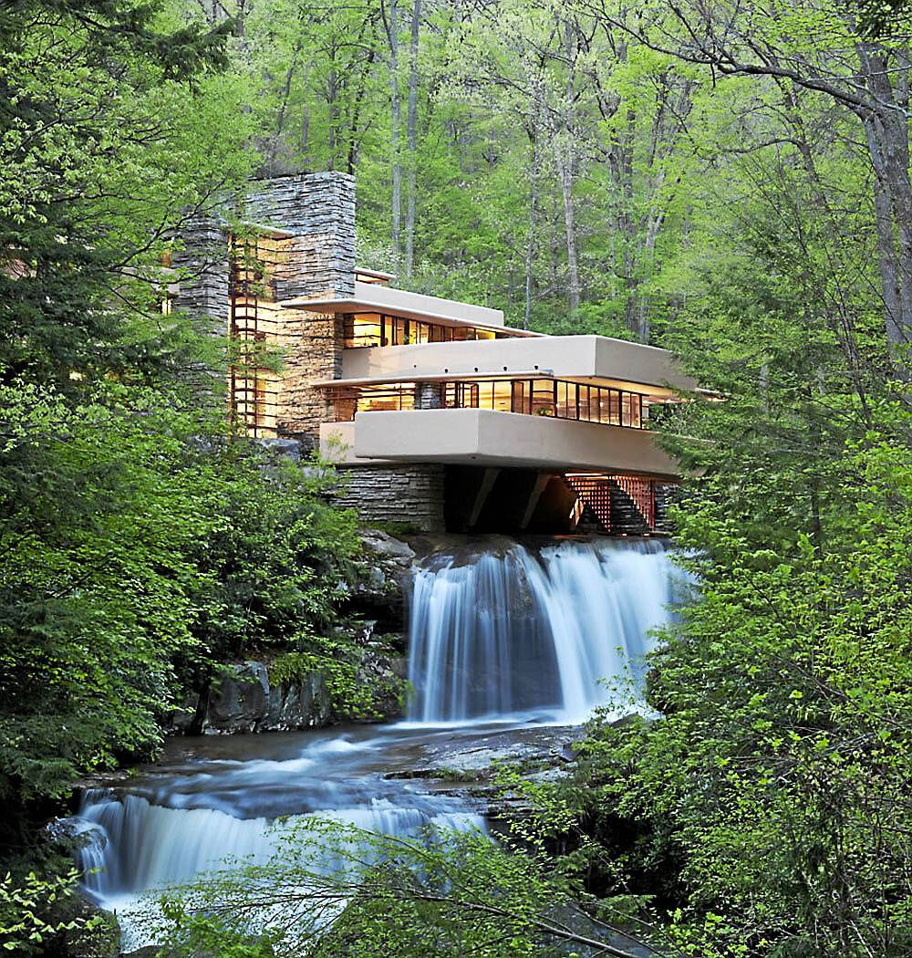
2 Form
When shape acquires depth and becomes three dimensional, it takes on form.
Three-dimensional art has an actual form (like in architecture) while two-dimensional pieces can have the illusion of form when the artist uses perspective or shading.
Some common forms are cones, pyramids, spheres, and cubes.

Slide 21
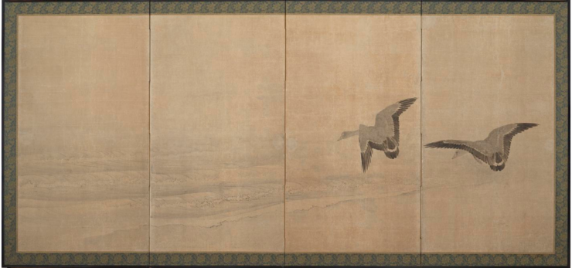
2 Space
Space is any area an artist creates for a specific purpose.
Space can be positive or negative.
  Positive space is an area occupied by an object or form.
  Negative space is the area that runs between, through, and around or within objects.
  This includes background, foreground, and middle ground.
Space that can be manipulated in art based on how an artist uses lines, shape, form, and color.

Slide 22
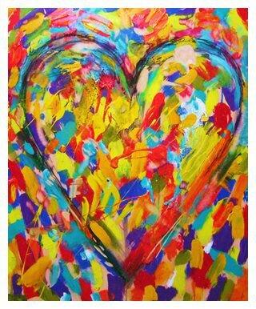
2 Color
There are three different components to color.
  Hue is the name we give the color (red, yellow, blue, etc.).
  Intensity refers to the vividness of the color (intensity can also be referred to as saturation or purity).
  Value means how dark or light a color is.
Color can be used symbolically or to produce a pattern or to show contrast in a piece.

Slide 23
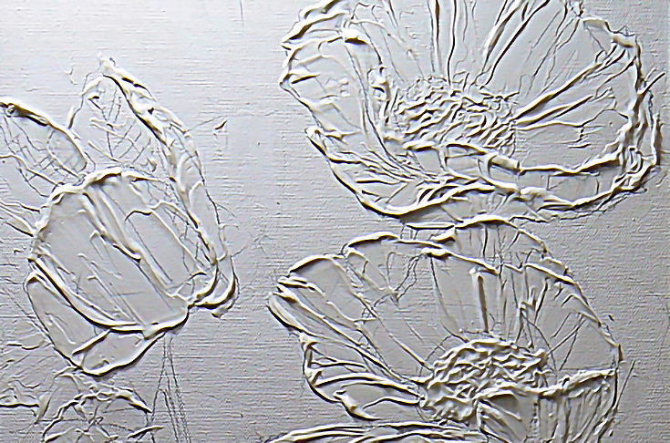
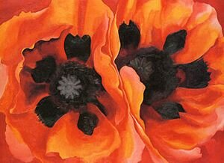
2 Texture
Texture is how an object looks or feels.
Sometimes texture can actually felt, such as in sculpture or the texture of work can be implied such as if you were to sketch a sheep’s wool.
Some words to describe texture include soft, hard, rough, brittle, fluffy, or smooth.

Slide 24
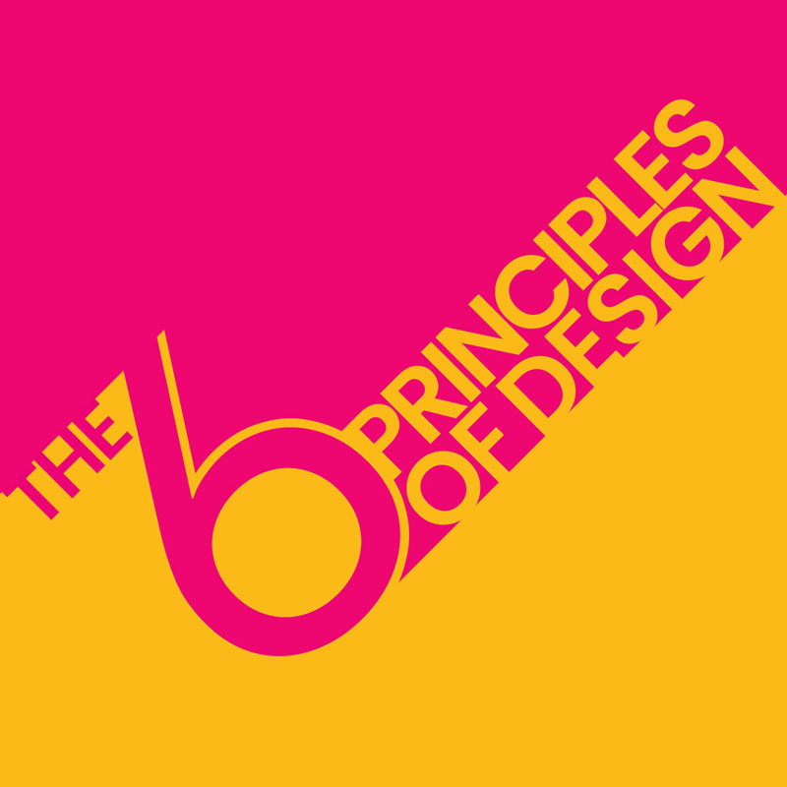
Requirement 3
Discuss with your counselor the six principles of design: rhythm, balance, proportion, variety, emphasis, and unity.

Slide 25

3 Rhythm
You have felt rhythm in music. Rhythm is also a part of things you see. It allows the eye to move from one part of a design to another part.
Rhythm can be created by:
  Repeating a color, shape, texture, line, or space when designing.
  Varying the size of objects, shapes, or lines in sequence (small to large).
  Using a progression of colors from tints to shades (light blue to dark blue).
  Shifting from one hue to a neighboring hue (yellow to yellow-orange to orange to red-orange to red).

Slide 26
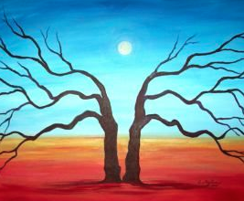
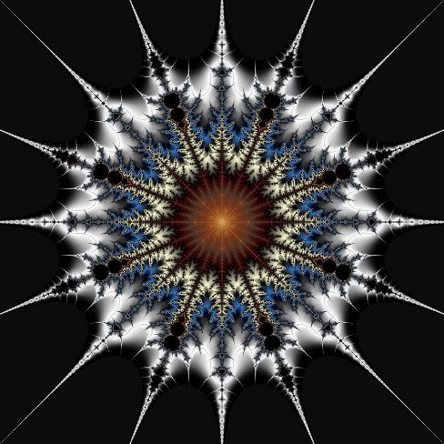
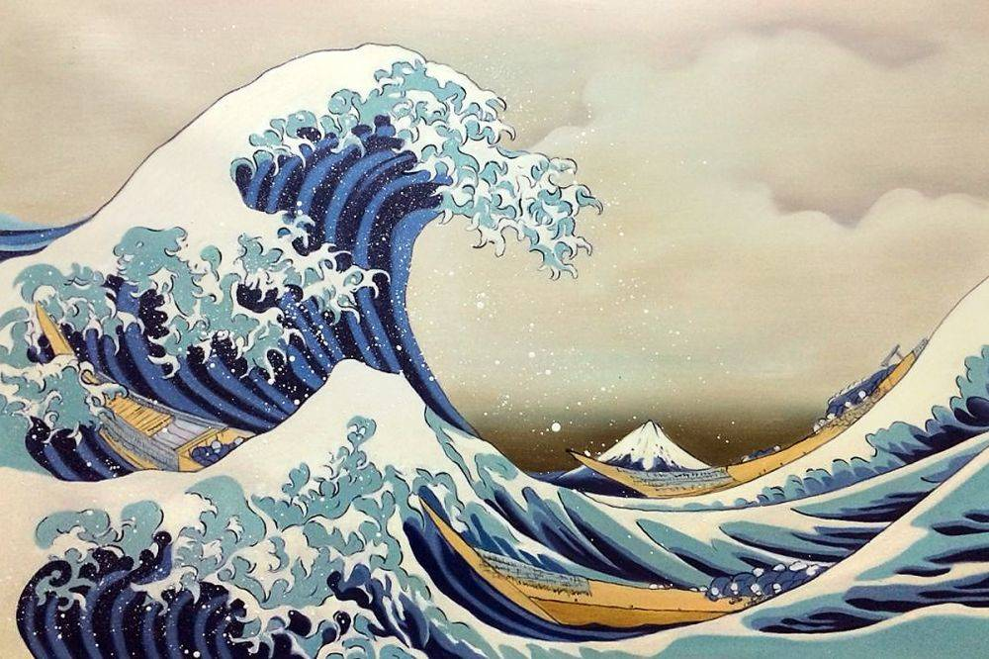
3 Balance
Balance gives a feeling of stability. There are three types of balance.
  Symmetrical, or formal balance, is the simplest kind. An item that is symmetrically balanced is the same on both sides. Our bodies are an example of formal balance. If you draw an imaginary line from your head to your toes dividing your body in half, you will be pretty much the same on both sides.
  Designs that have a radial balance have a center point. A tire, pizza, and a daisy flower are all examples of design with radial balance. When you look through a kaleidoscope, everything you see has a radial balance.
  Asymmetrical balance creates a feeling of equal weight on both sides, even though the sides do not look the same. Asymmetrical designs also are called informal designs because they suggest movement and spontaneity. Asymmetrical balance is the hardest type of balance to achieve and often takes experimenting or moving elements around until balance is achieved.

Slide 27
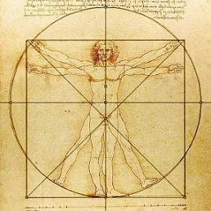
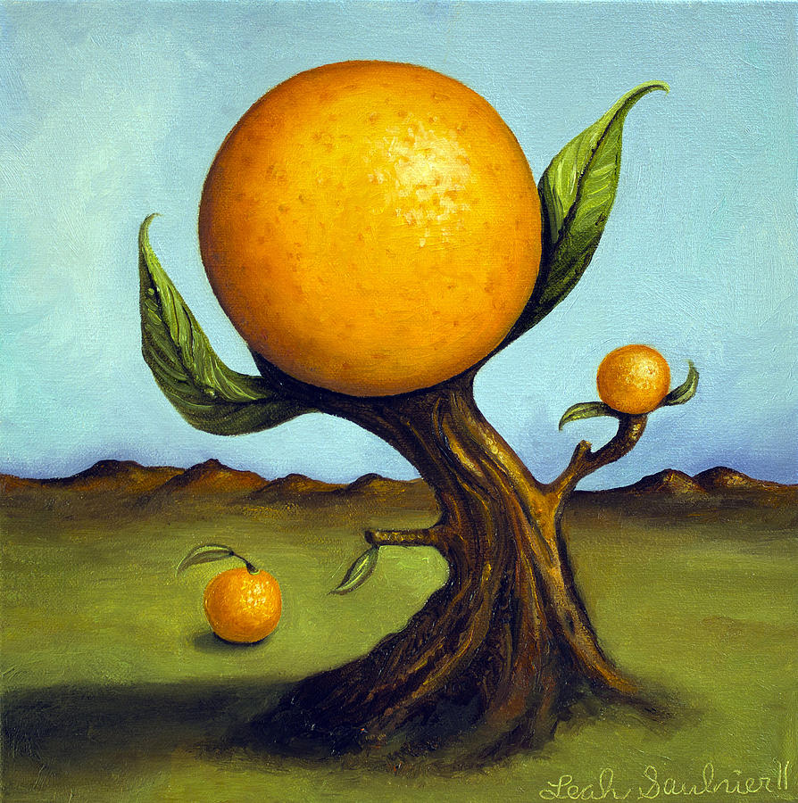
3 Proportion
Proportion in art can be defined as the relation based on size between parts or objects within a composition.
It is a comparison of sizes, shapes, and quantities.

Slide 28
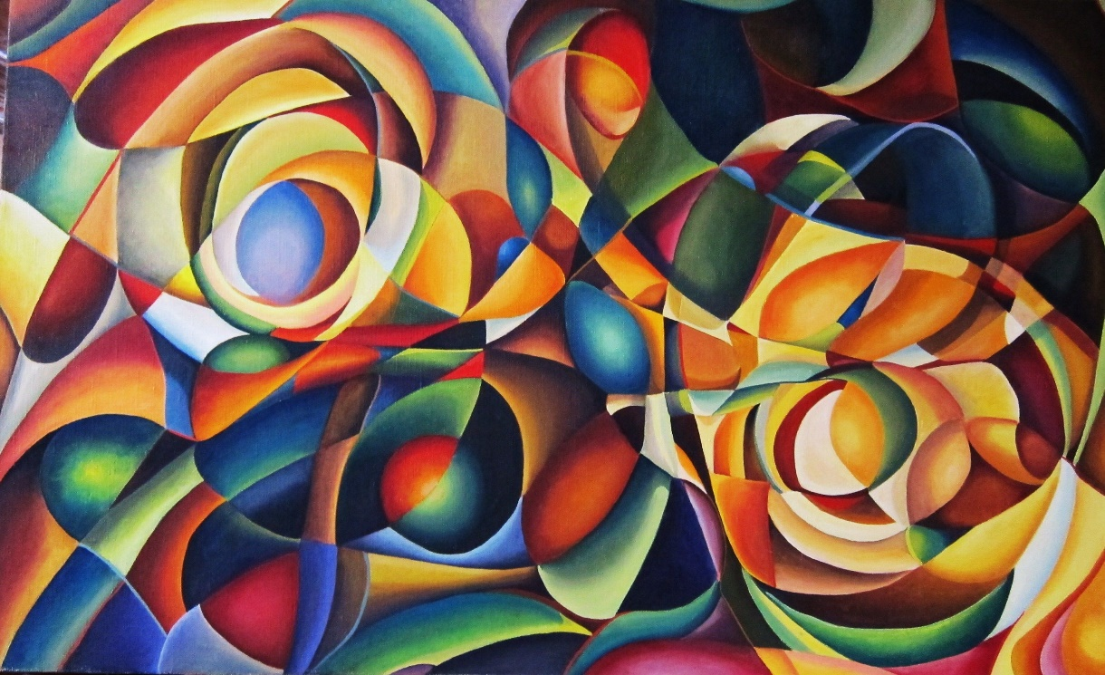
3 Variety
Variety is the use of several elements of design to hold the viewer’s attention and to guide the viewer’s eye through and around a work of art.

Slide 29
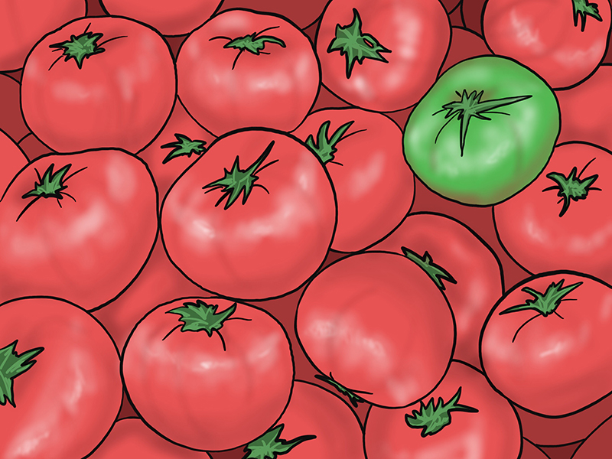
3 Emphasis
Every design needs an accent—a point of interest.
Emphasis is the quality that draws your attention to a certain part of a design first.
There are several ways to create emphasis:
  Use a contrasting color.
  Use a different or unusual line.
  Make a shape very large or very small.
  Use a different shape.
  Use plain background space

Slide 30
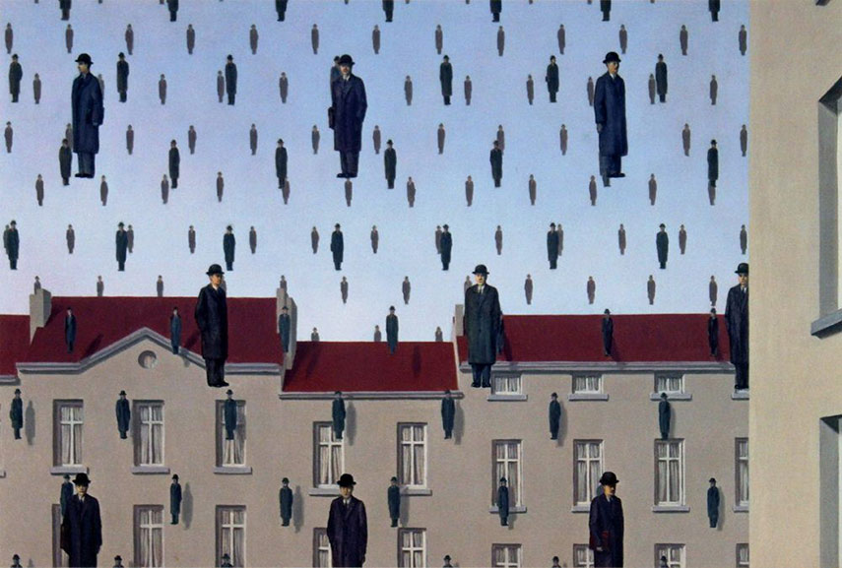
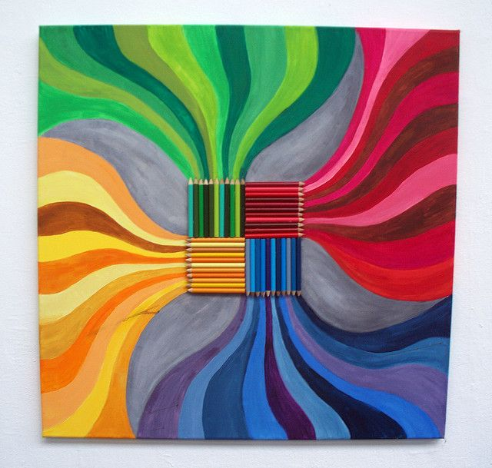
3 Unity
Unity is the feeling of harmony between all parts of a work of art, which creates a sense of completeness; the thing that joins the parts together.
When things look right together, you have created unity or harmony.
  Lines and shapes that repeat each other show unity (curved lines with curved shapes).
  Colors that have a common hue are harmonious.
  Textures that have a similar feel add to unity.
But too much uniformity sometimes can be boring.
At the same time, too much variety destroys unity.

Slide 31
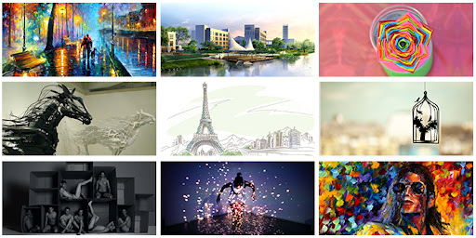
Requirement 4
Render a subject of your choice in FOUR of these ways:
  Pen and ink,
  Watercolors,
  Pencil,
  Pastels,
  Oil paints,
  Tempera,
  Acrylics,
  Charcoal
  Computer drawing or painting

Slide 32
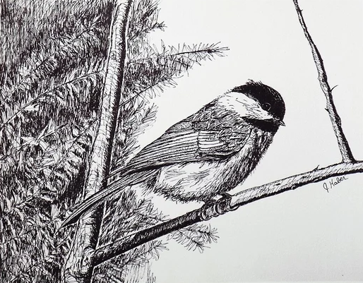
4a Pen and Ink
Pen and ink drawing describes the process of using pens to apply ink to a surface (generally paper).

Slide 33
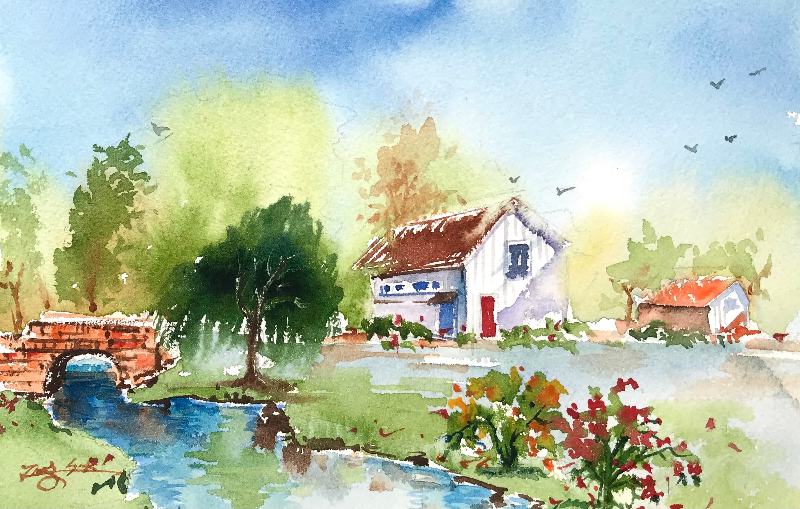
4b Watercolors
Watercolor is a painting method in which the paints are made of pigments suspended in a water-based solution.
Watercolor refers to both the medium and the resulting artwork.

Slide 34
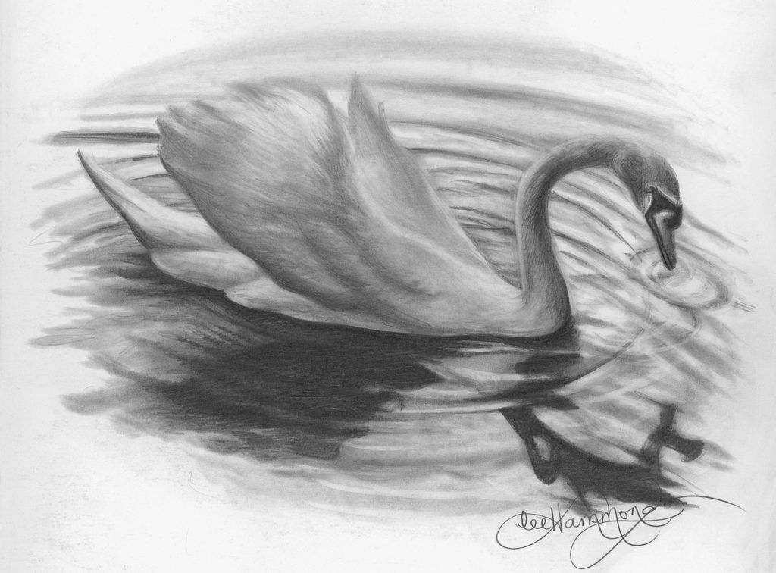
4c Pencil
Pencil drawing is done with an pencil and intended either as a sketch for a more elaborate work in another medium, an exercise in visual expression, or a finished work.
Pencils, including artists' pencils, are made of non-toxic graphite mixed with a little bit of clay and encased in wood.
Pencils use the letters H and B as classifications of different 'hardness' and 'blackness', respectively.
  That means they draw darker or lighter, depending on which pencil you use.
  The H pencils are known for creating light lines, whereas the B pencils create dark lines.

Slide 35
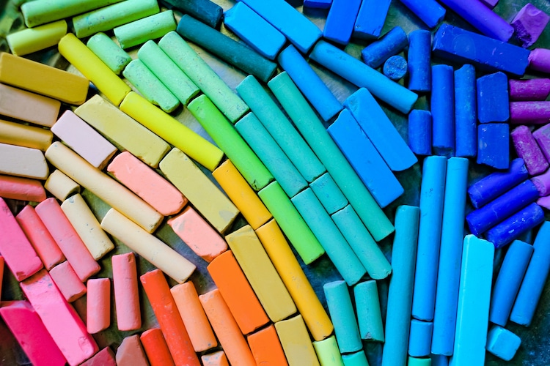
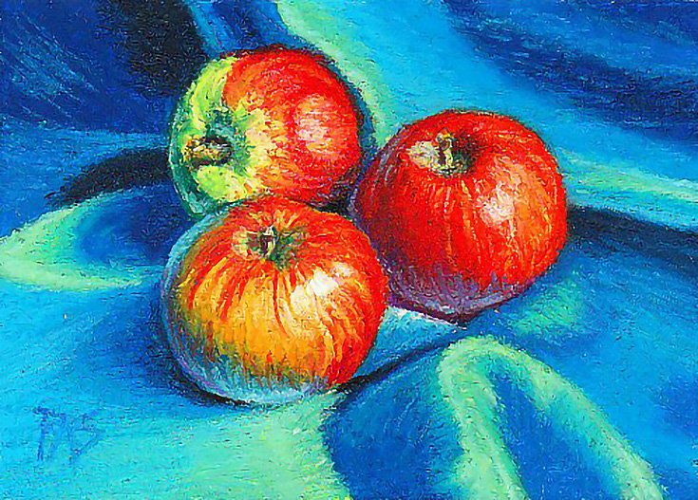
4d Pastels
A pastel is an art medium in the form of a stick, consisting of powdered pigment and a binder.
An artwork made using pastels is called a pastel (or a pastel drawing or pastel painting).

Slide 36
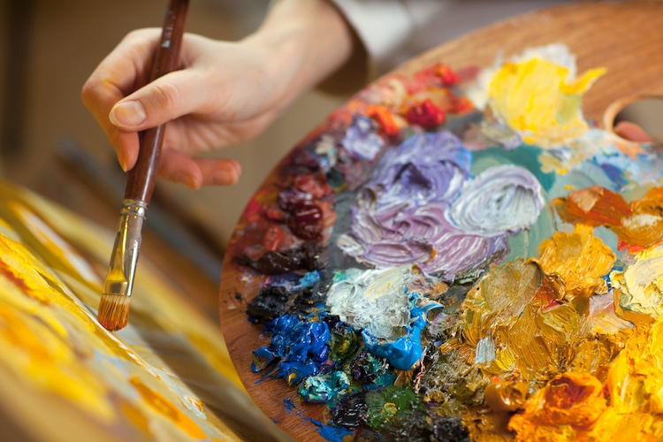
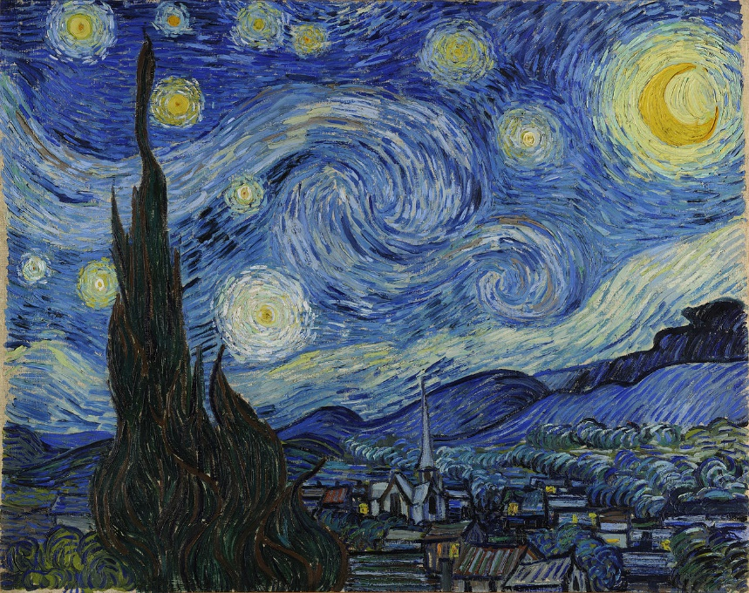
4e Oil Paints
Oil painting is the process of painting with pigments with a medium of drying oil as the binder.
Commonly used drying oils include linseed oil, poppy seed oil, walnut oil, and safflower oil.
The choice of oil imparts a range of properties to the paint, such as the amount of yellowing or drying time.

Slide 37
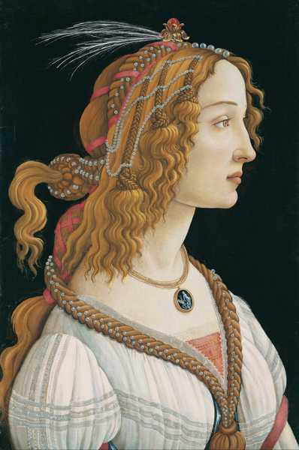
4f Tempera
Tempera, also known as egg tempera, is a permanent, fast-drying painting medium consisting of colored pigments mixed with a water-soluble binder medium, usually glutinous material such as egg yolk.

Slide 38
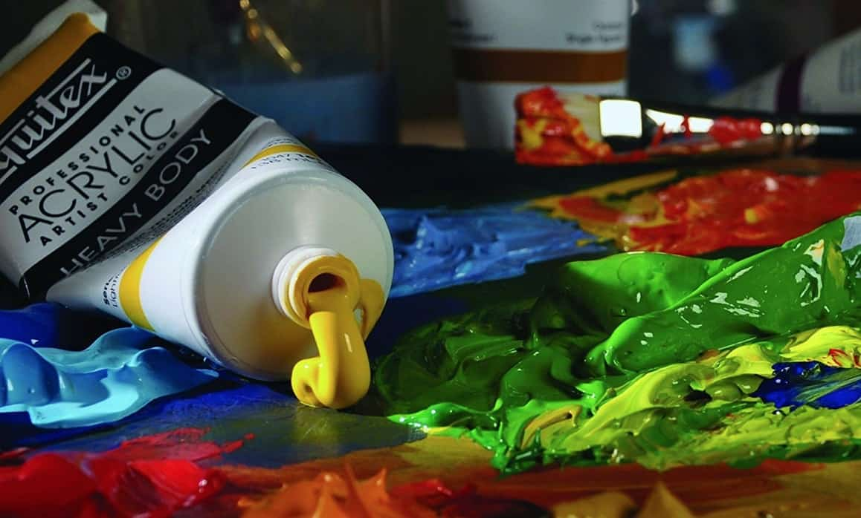
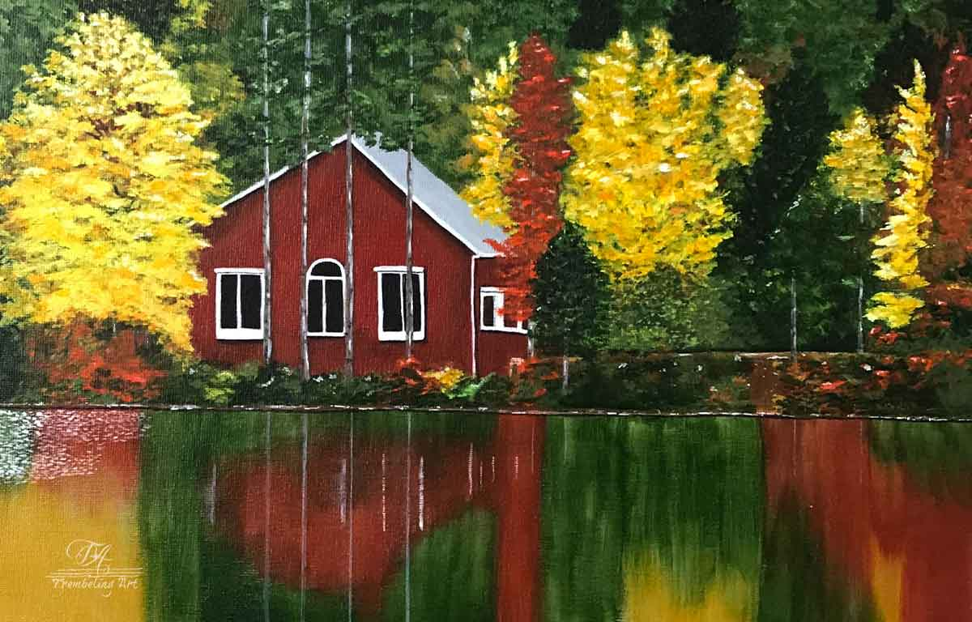
4g Acrylics
Water-based acrylic paint is composed of pigment particles dispersed in an acrylic polymer emulsion.
There are three main components in any acrylic paint - pigment, binder and vehicle:
  Pigment - pigments are granular solids which give paint its color. They are milled to a tiny particle size and do not dissolve, but remain suspended in the paint.
  Binder - a binder is the substance that keeps pigment in place after the paint dries. Acrylic paint has acrylic polymer as its binder and this forms a film after the water has evaporated
  Vehicle - this refers to the part of the paint that carries the pigment and binder. Water is the vehicle for water-based acrylic. Once the water leaves the system by evaporation or absorption, the paint dries, creating a stable clear polymer film full of trapped colored pigment particles

Slide 39
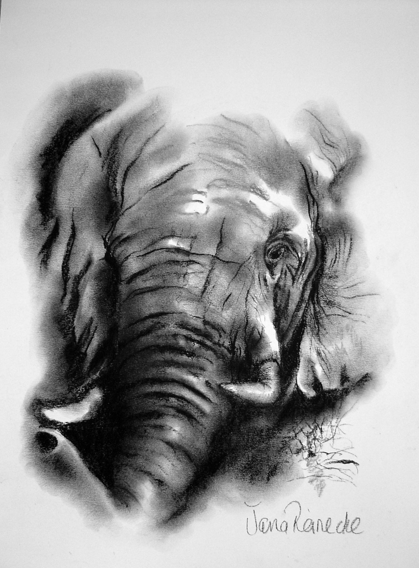
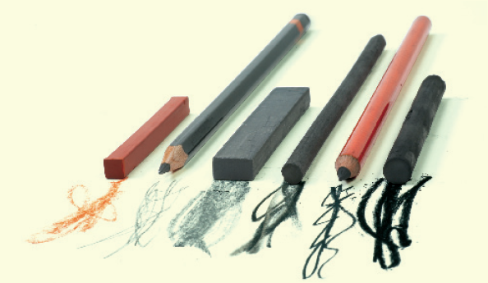
4h Charcoal
Charcoal is a black crumbly drawing material made of carbon and often used for sketching and under-drawing for paintings, although can also be used to create more finished drawings.

Slide 40
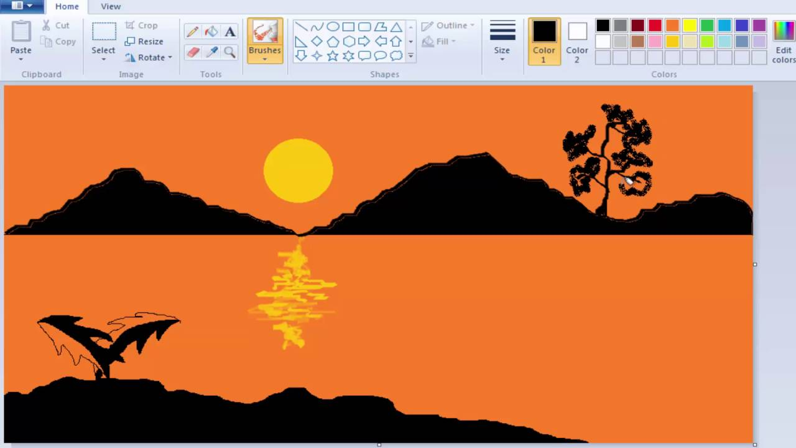
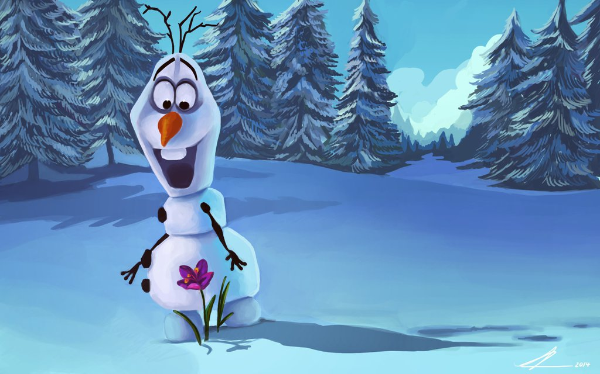
4i Computer Drawing or Painting
Computer or digital painting is an emerging art form in which traditional painting techniques such as watercolor, oils, impasto, etc. are applied using digital tools by means of a computer, a graphics tablet and software.

Slide 41
Requirement 5
Do ONE of the following:
  Design something useful. Make a sketch or model of your design. With your counselor's approval, create a promotional piece for the item using a picture or pictures.
  Tell a story with a picture or pictures or using a 3-D rendering.
  Design a logo. Share your design with your counselor and explain the significance of your logo. Then, with your parent's permission and your counselor's approval, put your logo on Scout equipment, furniture, ceramics, or fabric.

Slide 42
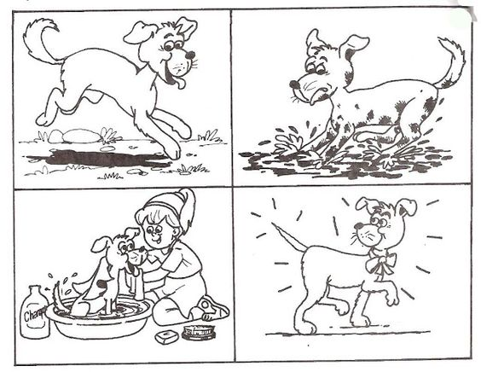
5b Tell a Story with Art
Works of art often tell stories.
Artists can present narrative in many ways—by using a series of images representing moments in a story, or by selecting a central moment to stand for the whole story.

Slide 43

5c Design a Logo

Slide 44
5c Design a Logo
How to Design a Logo (Even if You’re Not a Designer) – A website to help you learn about logo design.
  Think of a basic concept for your logo. Before you can begin putting together an eye-catching original logo, you’ll need to know what you want it to look like. Consider what the logo will be used for and try to find a way to distill it into a single image. Your logo should be a visual representation of your business, product, or brand.
    Some aspect of your brand, such as a name, theme, or mascot, may provide inspiration for your logo. A logo for a company called “Caveman Donuts,” for instance, might depict a caveman tinkering with a "wheel" covered in frosting and sprinkles.
  Look at iconic logos for inspiration. If you're not sure where to begin, make a note of the way popular businesses and products are marketed. Run an image search for famous company logos to get a good overview, or start paying attention to signs, billboards, and product packaging. Taking cues from some of the most enduring images in advertising can help you step up your own designs.
    Be careful not to make your design too similar to any well-known logos. A suspicious resemblance could be considered copyright infringement.

Slide 45
5c Design a Logo
Settle on a design that's fresh and innovative. A focused theme, simple yet inventive visual characteristics, and an instant association with your brand are all elements of a memorable logo. It's especially important to strike the right balance between detail and directness. Your logo should be identifiable enough to attract attention at a glance, but not so busy that it's off-putting.
  Minimalistic logos are all the rage nowadays. A few well-placed lines may be all you need to piece together a sleek, subtle design without a lot of frills.
Decide whether to use text, images, or both. Determine how elaborate you want your logo to be. It could feature a colorful piece of original artwork, or you might simply leave it as a name or symbol. You want the finished product to stand out, so get creative!
  If you don’t want to include images, try turning part of the text itself into the focal point of the design—a stylized letter “W” could stand on its own in a logo for “Wally’s Video Game Reviews.”
  Keep in mind that the more detailed your design is, the more difficult it will be to bring it to life using an online photo editor.

Slide 46
5c Design a Logo
Sketch out your logo. Take your time committing your logo to paper. It doesn’t need to be perfect just yet, but you should be careful to make sure it contains all of the elements you conceived of for your design. Complete multiple drafts to experiment with possible variations and refine your basic concept.
  Use a pencil to put down the first draft of your logo. That way, you’ll be able to easily make changes and revisions as needed later on.
  Keep it simple. Avoid too many colors, multiple fonts and layered images. A confusing or cluttered logo won't convey a clear message.
Create a finished version of the logo. Go back and put the finishing touches on your rough draft by cleaning up your linework and correcting any mistakes you may have made. This time, you can use an ink pen or felt tipped marker to go over the edges. Retracing key areas will make your design more bold and make sure the emphasis is in the right place.
  Lightly shade or color in open sections to create a mockup of how your design will appear.

Slide 47

Requirement 6
With your parent's permission and your counselor's approval, visit a museum, art exhibit, art gallery, artists' co-op, or artist's workshop. Find out about the art displayed or created there. Discuss what you learn with your counselor.

Slide 48


5d Visit a Museum or Gallery
Toledo Museum of Art
  2445 Monroe Street
  Toledo, OH 43620
  419-255-8000
University of Findlay's Mazza Museum
  Virginia B. Gardner Fine Arts Pavilion.
  201 College Street, Findlay, OH 45840 419-434-4560
  mazzamuseum@findlay.edu

Slide 49

Requirement 7
Find out about three career opportunities in art. Pick one and find out the education, training, and experience required for this profession. Discuss this with your counselor, and explain why this profession might interest you.
WHO IS AN ARTIST?

Slide 50

5e Careers in Art
The Art Career Project is a website that allows you to explore hundreds of career profiles related to the arts and learn more about what it takes to build long-term careers within today’s top creative industries.

